Slide 1
Logistic Regression

Slide 2
What is Logistic Regression?
Logistic regression machine learning is a statistical method that is used for building machine learning models where the dependent variable is dichotomous: i.e. binary.
The name “logistic regression” is derived from the concept of the logistic function that it uses. The logistic function is also known as the sigmoid function.
The value of this logistic function lies between zero and one.

Slide 3
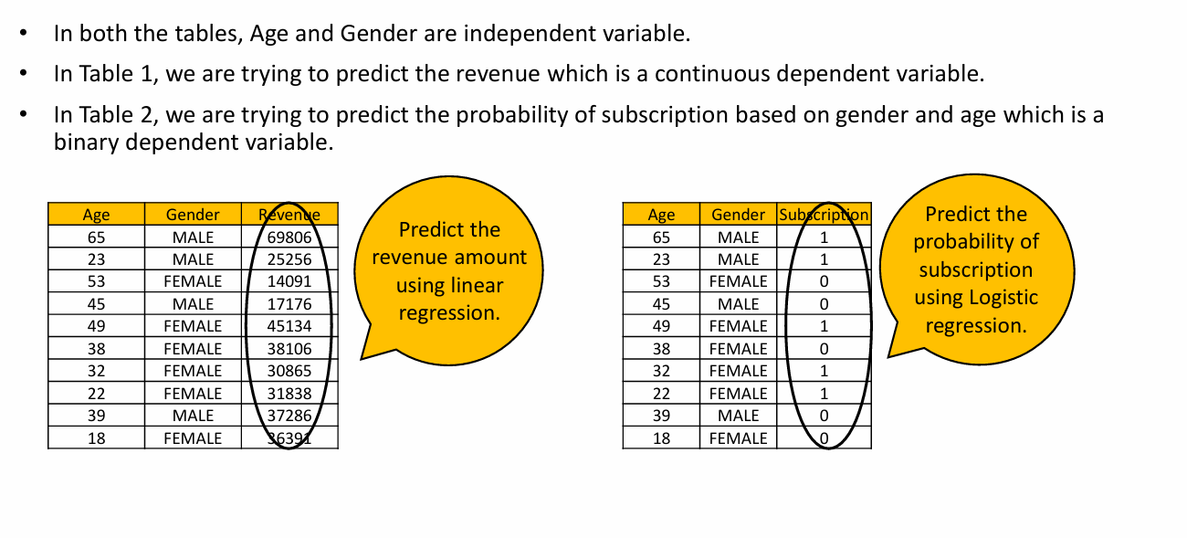
Case Study

Slide 4
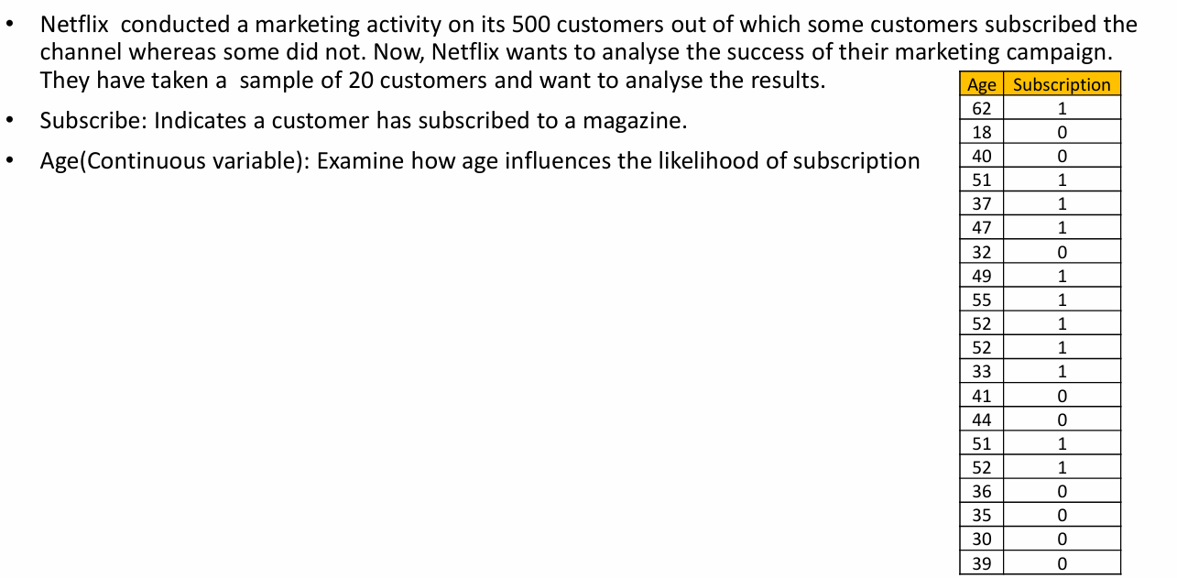
Problem Statement of Case Study

Slide 5
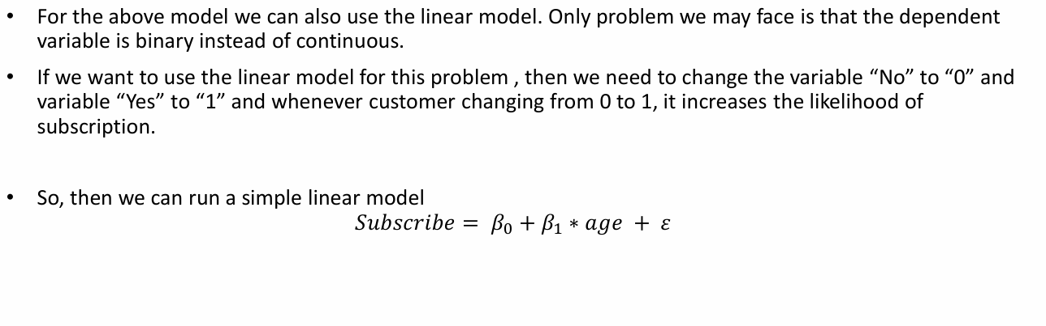
A Linear Model?

Slide 6
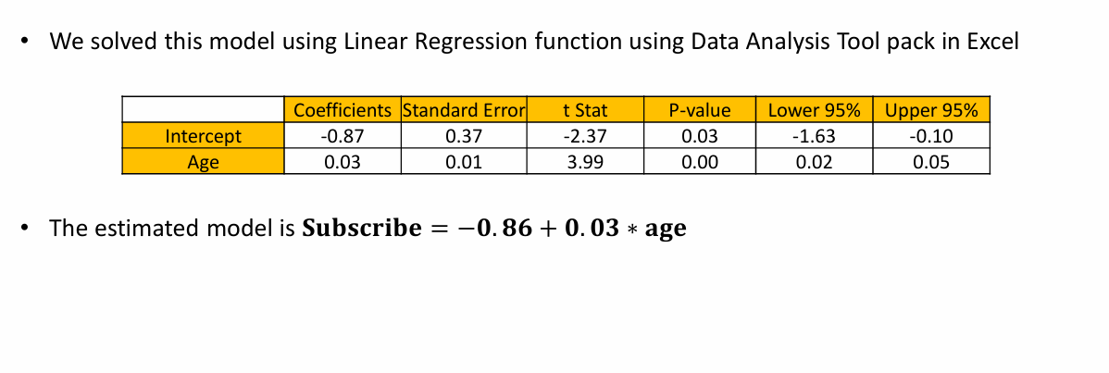
Result of Linear Model

Slide 7
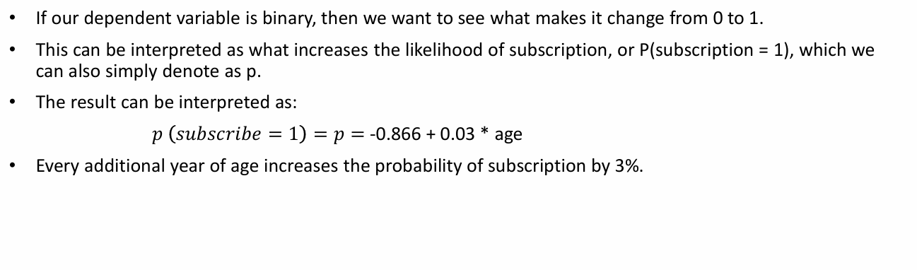
Interpretation of result

Slide 8
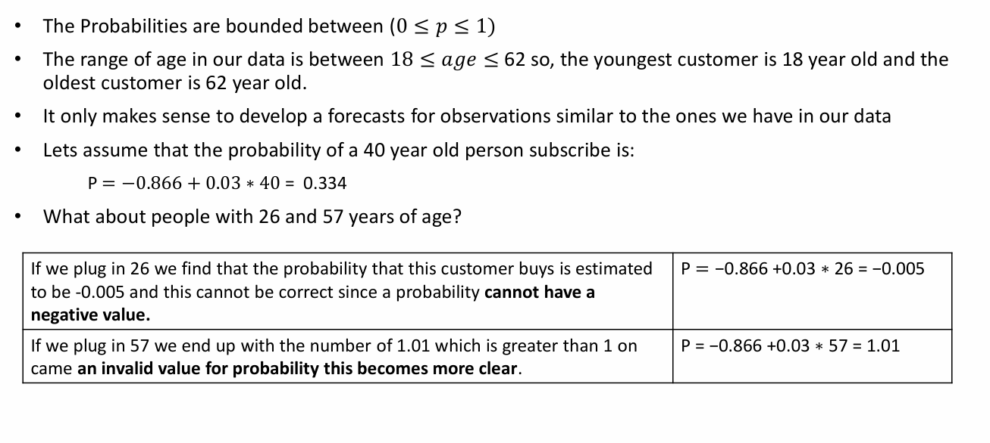
Problems with the linear Approach

Slide 9
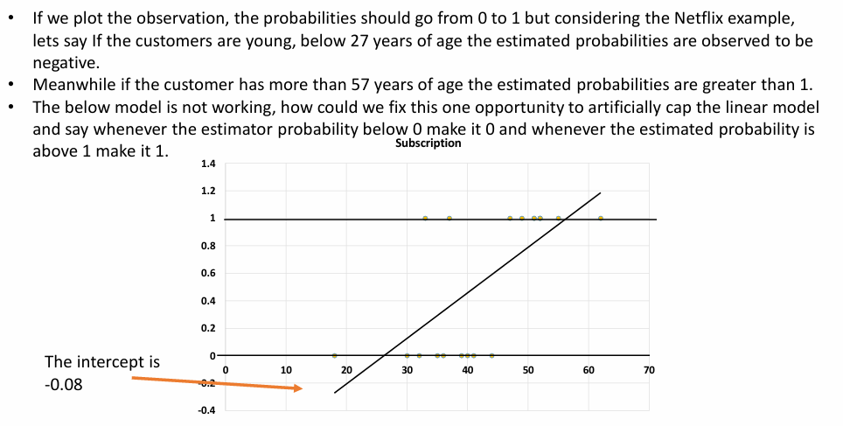
Linear Model

Slide 10

Then what is the solution?

Slide 11
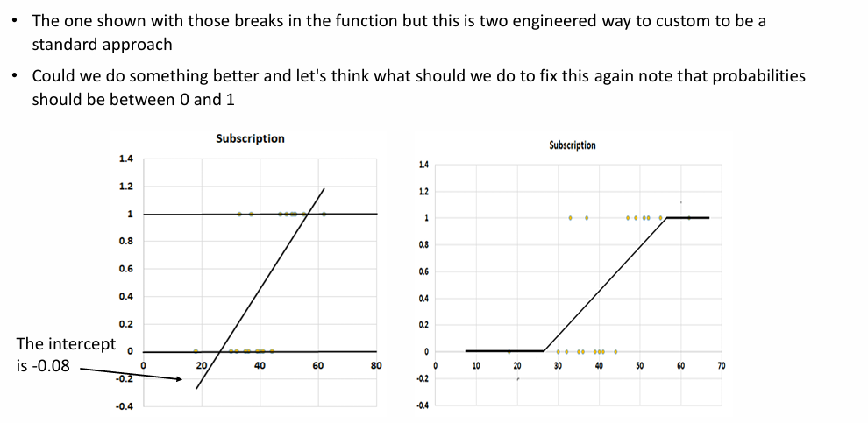
The solution is….

Slide 12
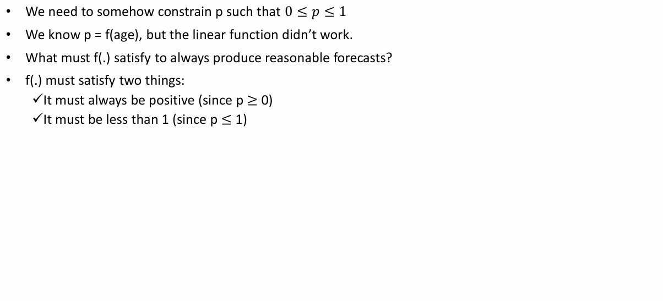
Fixing the Prior Approach

Slide 13
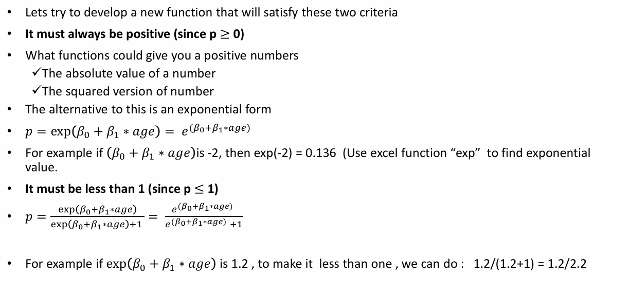
Two Steps – Step1

Slide 14
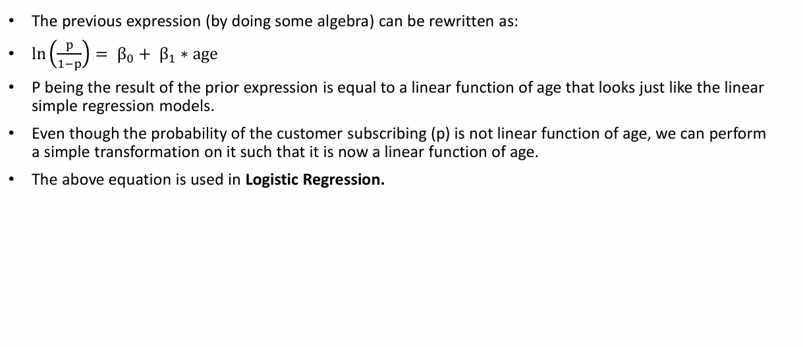
Step 2

Slide 15
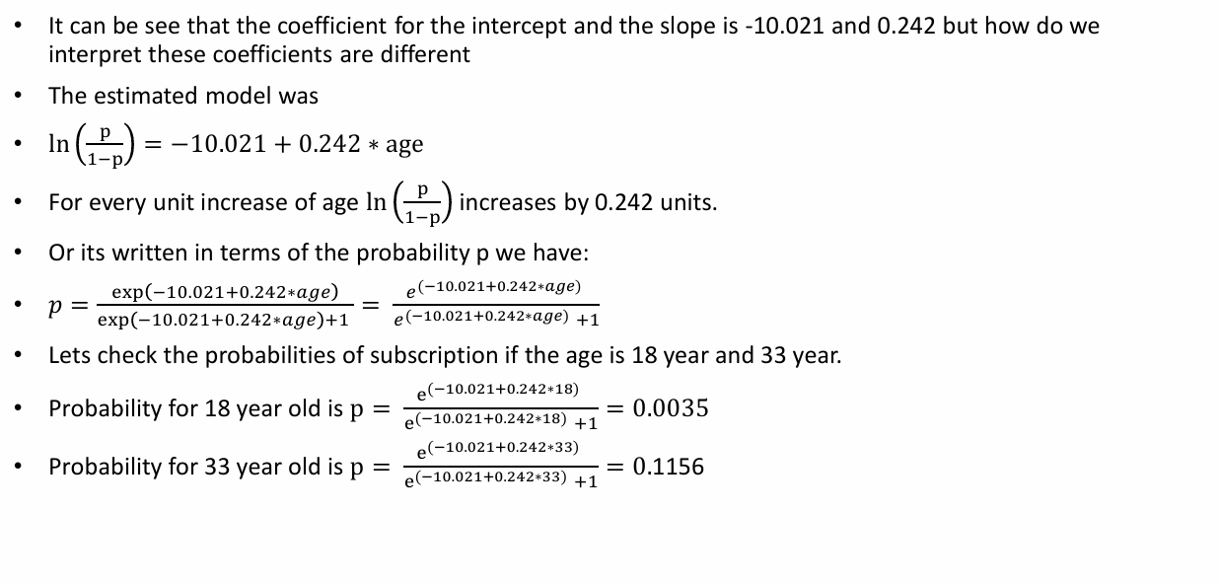
The estimated Logistic Model

Slide 16
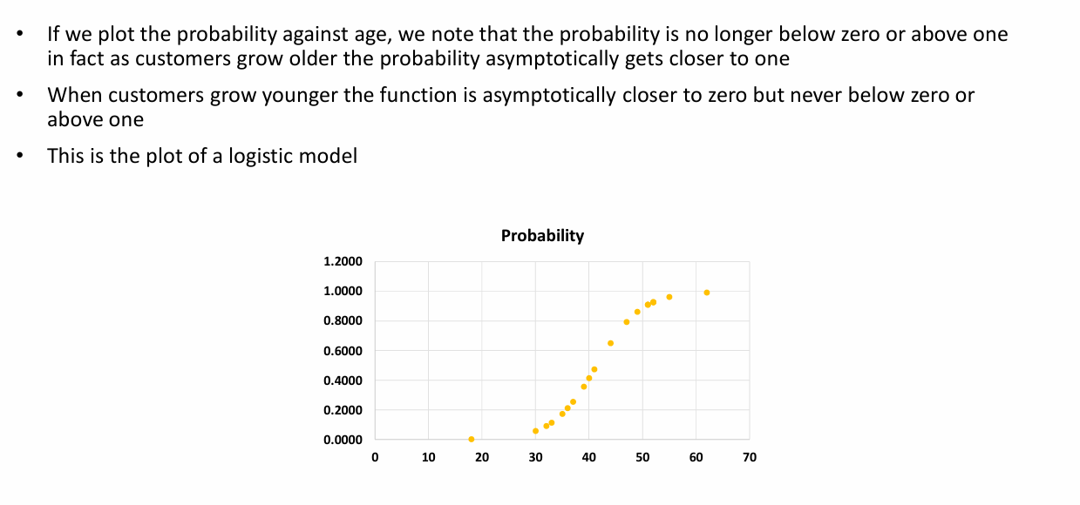
Logistic Model Plot

Slide 17

Questions?

